Slide 1

Kammavari Sangham (R) 1952, K.S.Group of Institutions
K. S SCHOOL OF ENGINEERING AND MANAGEMENT, BENGALURU-560109
(Affiliated to VTU, Belagavi & Approved by AICTE, New Delhi, Accredited by NAAC)
DEPARTMENT OF COMPUTER SCIENCE AND ENGINEERING Project Work Phase-2 (18CSP83) : Review-1
“CREDIT CARD FRAUD DETECTION USING MACHINE LEARNING”
Batch No:B18
Group No:G2
Name | USN
Bhargav M | 1KG19CS009
Gaurav G | 1KG19CS032
Harsith S | 1KG19CS037
Suhail Ahmed Sayyed | 1KG19CS100
Under the Guidance of
Mrs Belji T
Department of Computer Science and Engineering

Slide 2
Introduction
Literature survey
Problem Statement
Objectives
Methodology
High level design(For Ex- Sequence/ Use case / Data flow diagram)
Technology & Tools Used
Implementation / Snapshots
Conclusion and future enhancements
References
AGENDA

Slide 3
INTRODUCTION
'Fraud' in credit card transactions is unauthorized and unwanted usage of an account by someone other than the owner of that account.
Fraud detection involves monitoring the activities of populations of users in order to estimate, perceive or avoid objectionable behaviour, which consist of fraud, intrusion, and defaulting.
The different classification techniques we have applied in this study for fraud detection purposes are logistic regression, decision tree, random forest, KNN.

Slide 4
It requires training and testing data for comparing credit card transactions,if the output value is 1 then it is a fraudulent transaction else if output value is 0 then it is legit transaction.
It tests all the ML techniques and data models.It provides individual accuracy of data model and finally selects the model with higher accuracy.

Slide 5
Literature survey
Credit Card Fraud Detection System
Massive usage of credit cards has caused an escalation of fraud. Usage of credit cards has resulted in the growth of online business advancement and ease of the e-payment system. The use of machine learning (methods) are adapted on a larger scale to detect and prevent fraud. ML algorithms play an essential role in analysing customer data. In this research article, we have conducted a comparative analysis of the literature review considering the ML techniques for credit card fraud detection (CCFD) and data confdentiality.

Slide 6
A Survey Paper on Credit Card Fraud Detection Techniques.
A credit card is the most widely used electronic payment method because of the increasing volume of daily electronic transactions.The detection of credit card fraud is currently the most common issue. There are several methods for identifying credit card fraud that has been surveyed and highlighted in this paper and has been compared in terms of disadvantages and advantages for each one. The advantage is we are using decision tree to limit the credit card transactions to prevent risks and frauds.

Slide 7
Literature Review of Different Machine Learning Algorithms for Credit Card Fraud Detection
The prediction analysis is the approach which can predict future possibilities on the current data.When the physical-card based purchasing technique is applied, the card is given by the cardholder to the merchant so that a successful payment method can be performed. The fraudulent transactions are conducted by the attacker by stealing the credit card. When the loss of the card is not noticed by the cardholder, a huge loss can be faced by the credit card company. A very little amount of information is required by the attacker for conducting any fraudulent transaction in online transactions.

Slide 8
Exploratory analysis of credit card fraud detection using machine learning techniques
In today’s world, a lot of processes are carried over the Internet to make our lives easier. But, on the other hand, many unauthorized and illegitimate activities that take place over it are causing major trouble for the growth of the economy. Several companies have started their study in this regard and have formulated data driven models that use various Machine Learning algorithms and models on datasets to analyse false activity. Several techniques used are Decision tree, Random Forest and their mixtures.The effectiveness of the algorithms varies on the set of data and the instance in which it is used.

Slide 9
Reducing false positives in credit card anti-fraud systems based on rule induction in distributed tree-based models
Fraud detection in bank payments transactions suffers from a high number of false positives. To deal with this problem, we introduce a rules generation framework for a fraud-detection system – an automatic rules generation using distributed tree-based ML (machine learning) algorithms such as Decision Tree & Random Forest where the components of expert rules are used as the features for the model. We apply it to the bank’s card transaction data. Our dataset covers February 2021 and consists of more than 20 mil. Records including information on clients, transactions, and merchants. The autogenerated rules were aimed at improving FPR (false positive rate) business-metric.

Slide 10
PROBLEM STATEMENT
“ Modeling past credit card transactions with the knowledge of ones that turned out to be fraud and using it to identify the transaction is fraud or not.”

Slide 11
OBJECTIVES
Detect The fraudulent Transactions.
Minimization of credit card fraud.
Analysis Multiple Machine Learning Algorithm.
Better performance and accuracy.

Slide 12
METHODOLOGY
Methodology of objective-1: False declines or false positives happen when a system identifies a legitimate transaction as suspicious and wrongly cancels it.
Methodology of objective-2: Enables analysts to identify new suspicious patterns and create new rules to prevent new types of scams.
Methodology of objective-3: Machine learning tools have higher precision and return more relevant results as they consider multiple additional factors. This is because ML technologies can consider many more data points, including the tiniest details of behavior patterns associated with a particular account.
Methodology of objective-4:Less manual work needed for additional verification. Enhanced accuracy leads reduces the burden on analysts. People are unable to check all transactions manually.

Slide 13
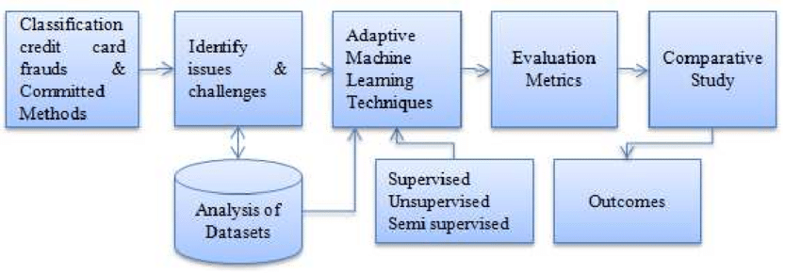
Fig 1: Block Diagram

Slide 14
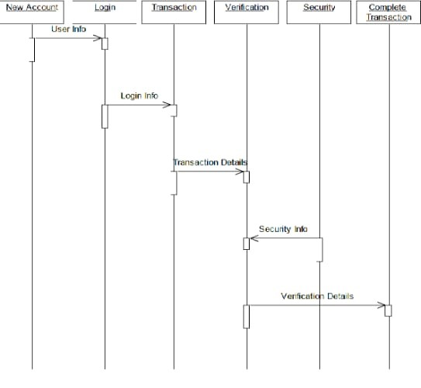
DESIGN
Fig 2: Sequence Diagram

Slide 15
TECHNOLOGY AND TOOLS USED
Software Requirements
Jupyter Notebook(Python)
Anaconda
Kaggle Dataset
Google Chrome

Slide 16
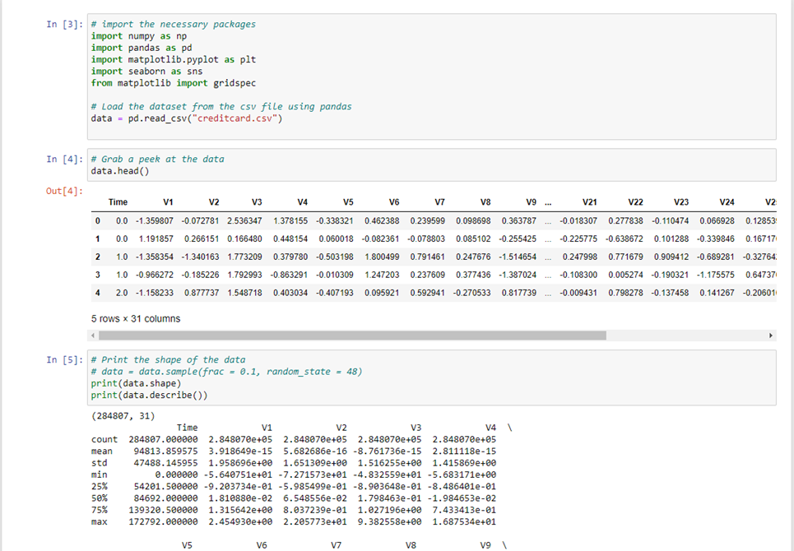
IMPLEMENTATION
Fig 3 : Code

Slide 17
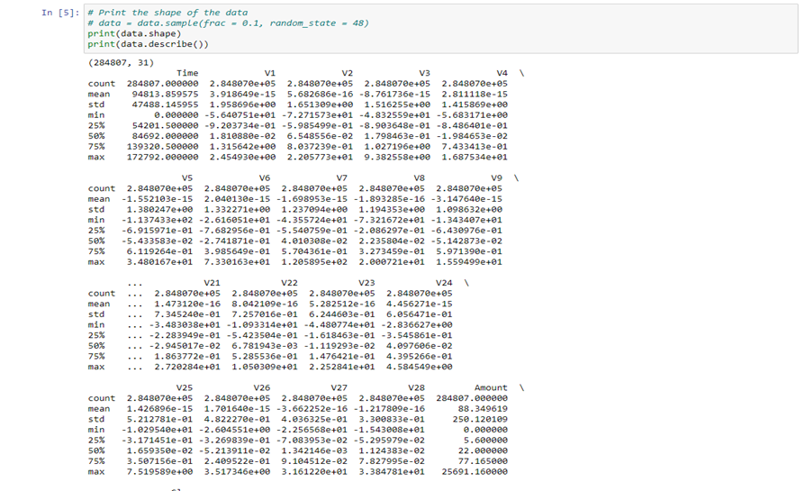
Fig 4 : Code Continued

Slide 18
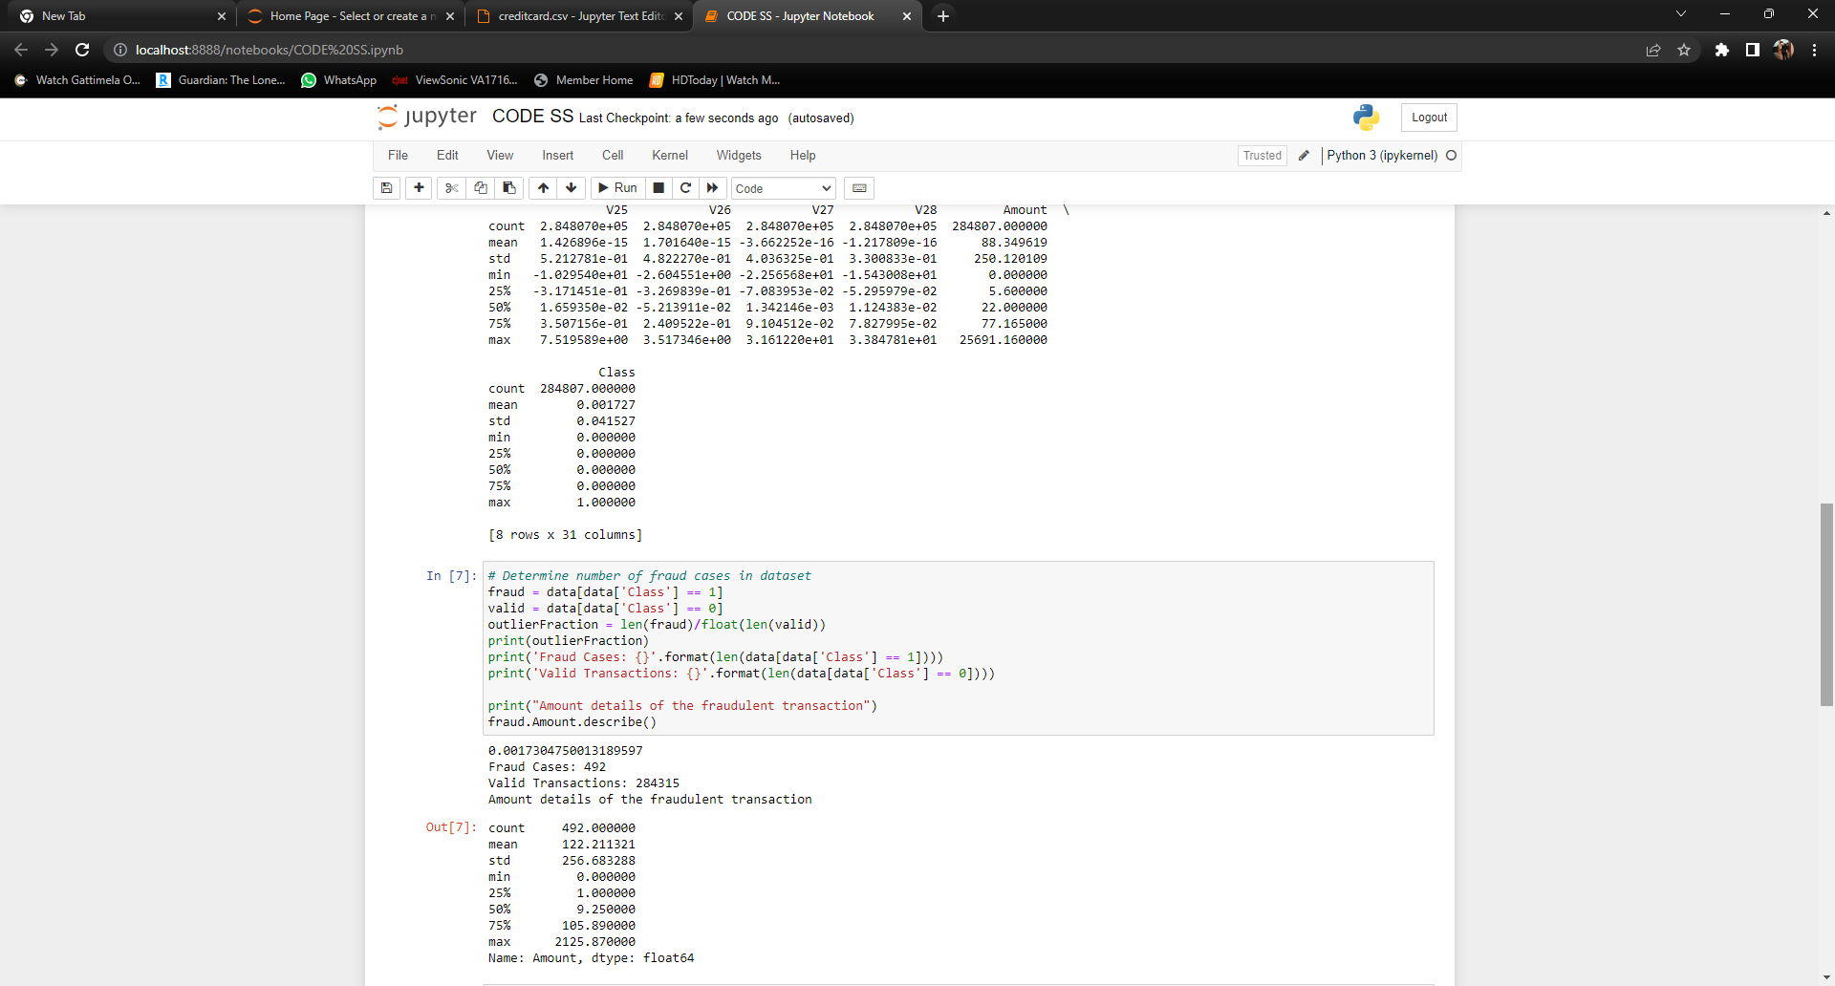
Fig 5 : Code Continued

Slide 19
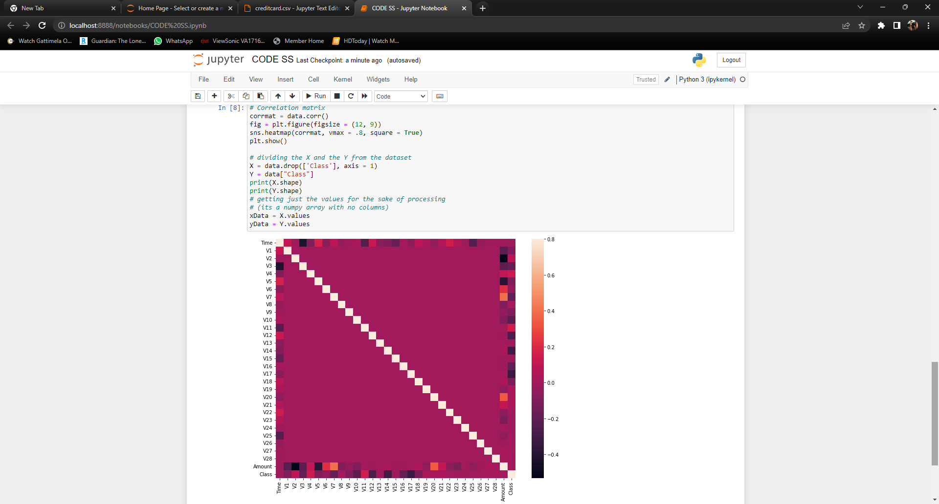
Fig 6: Code Continued

Slide 20
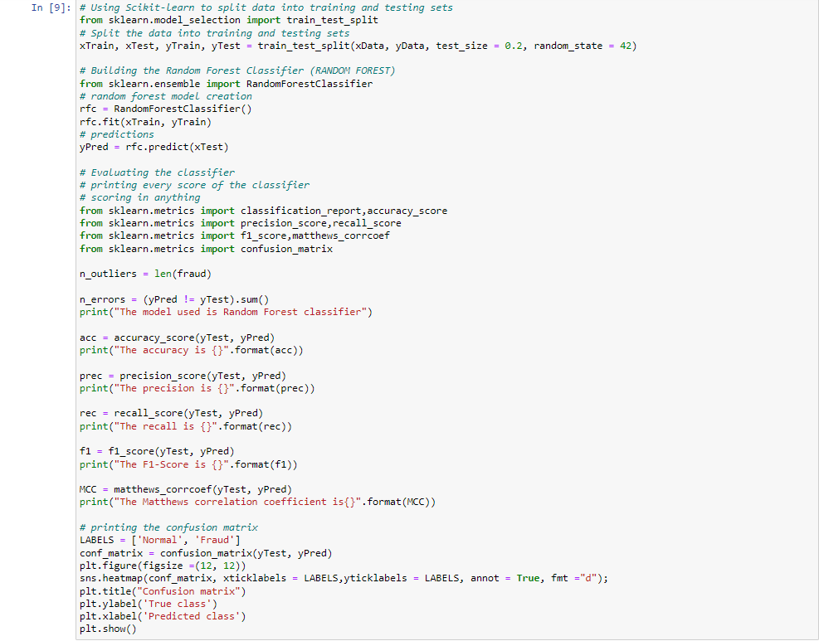
Fig 7: Code Continued

Slide 21
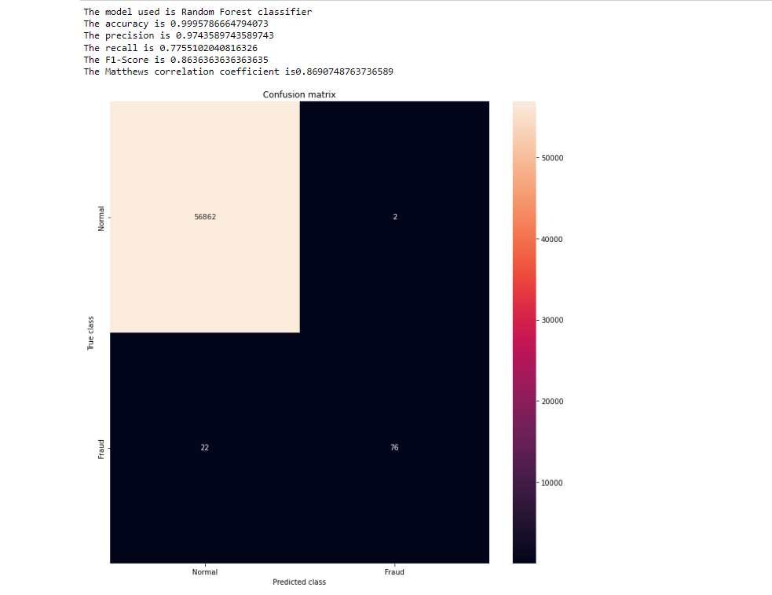
Fig 8: Code Continued

Slide 22
CONCLUSION AND FUTURE ENHANCEMENTS
CONCLUSION: This project helps in predicting fraudulent transactions for the given dataset. We are implementing ML algorithms like KNN, DecisionTree, Random Forest, Logistic Regression and choosing the most accurate and time efficient.We are enhancing credit card fraud detection which is a priority for banks and financial organizations.We are identifying suspicious events and reporting them to an analyst while letting normal transactions to be automatically processed.
FUTURE ENHANCEMENTS:
Minimizing errors, improving accuracy and keeping the design as simple as possible.
Making testing and training data equal in the referred dataset.
Location tracing and blocking of credit cards for better security when fraudulent transaction is detected.

Slide 23
REFERENCES
[1] Omar, Kazi Shahrukh, Prodipta Mondal, Nabila Shahnaz Khan, Md Rezaul Karim Rizvi, and Md Nazrul Islam. "A machine learning approach to predict autism spectrum disorder." In 2019 International conference on electrical, computer and communication engineering (ECCE),IEEE, 2019.
[2] Akter,Tania, Md Shahriare Satu, Md Imran Khan, Mohammad Hanif Ali, Shahadat Uddin, Pietro Lio, Julian MW Quinn, and Mohammad Ali Moni. "Machine learning-based models for early stage detection of autism spectrum disorders." IEEE,2019.
[3] Baranwal, Astha, and M. Vanitha. "Autistic spectrum disorder screening: prediction with machine learning models." In 2020 International conference on emerging trends in information technology and engineering (ic-ETITE), pp. 1-7. IEEE,2020.
[4] Eni, M, Dinstein, I, Ilan, M., Menashe, I, Meiri, G, & Zigel, Y. Estimating Autism Severity in Young Children From Speech Signals Using a Deep Neural Network. IEEE 2020
[5] Raj, S, & Masood, S. (2020). Analysis and Detection of Autism Spectrum Disorder Using Machine Learning Techniques. Procedia Computer Science.

Slide 24
THANK YOU

